Slide 1
UART Thou Mad?
Mickey and Toby

Slide 2
Legal Notice
Our opinion is our own. It DOES NOT IN ANY WAY represent the view of our employers.

Slide 3
whoami - Mickey

Slide 4
whoami - Toby

Slide 5
Agenda
Intro
UART
Background
Finding it
Embedded systems overview
Tools overview
UART’s greatest hits
Look what we can do
Protecting your embedded device
Conclusion

Slide 6
Intro
This talk is about sharing our experience
WINs
FAILs
Teach you a little bit more about how to use this feature to feed your curiosity

Slide 7
UART Background
UART = Universal Asynchronous Receiver/Transmitter
What is it? Who knows! We think it might be gnomes.
Where did it come from?
Heaven?
Gordon Bell is referenced as designing UART interfaces for the PDP series.
What matters is what goes through it.
Data. Raw data.
Between various components in a device
And how embedded OSs treat it
Frequently as a TTY or Console
Notes:
Component examples – GPS to CPU,

Slide 8
UART Background cont.
What is it for?
Officially - translating data between parallel and serial formats.
In practice
Providing interconnect between components
Providing a debug console interface for embedded devices
Why not just use JTAG?
UART doesn’t play hard to get
Less complex
Doesn’t require a debugger
No need to know assembly

Slide 9
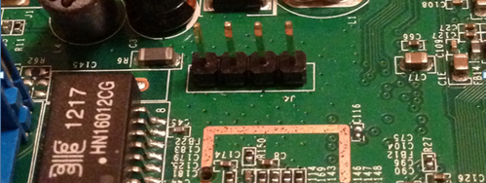
Finding UART
Look for four pins that look something like this:

Slide 10
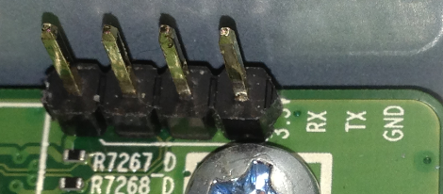
More Finding UART
Frequently the pins are tagged like this
That’s
3.3v
RX
TX
GND

Slide 11
(slightly) Advanced Finding UART
Find “interesting” pins or pads in a row
Almost always a group of four
Find ground (how? More about that later)
Warning! Make sure the voltage isn’t too high for your tools
Connect Ground to your tool (probably a BusPirate™)
Boot the device
While booting, touch the remaining pads/pins with your RX line one at a time
Going to require multiple reboots
See something that isn’t garbage? Win!
Notes:
Mickey will explain “interesting”

Slide 12


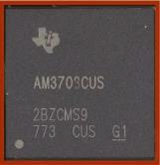
Embedded Systems
Made out of flash, RAM and an SoC
Samsung 512 Mb mobile DRAM
Micron 2 Gb NAND flash memory
Texas Instruments Sitara ARM Cortex A8 microprocessor

Slide 13
Embedded Systems
Usual configuration on PCB's (test point grouped together the same way)
(ab)Using the UART interface
OS will vary depending on vendor preference
Linux
RTOS of some flavor

Slide 14
Embedded Systems
NOT JUST ROUTERS, there is a whole world of devices out there!
Smart home power controllers
WebCams
HD TV streamers
Set-top boxes
Blueray players
….

Slide 15
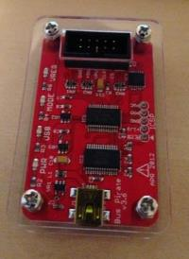
Tools Overview
FCC-ID database!
It is your best friend in finding interesting devices
BusPirate
Hardware hacker’s Swiss army knife

Slide 16
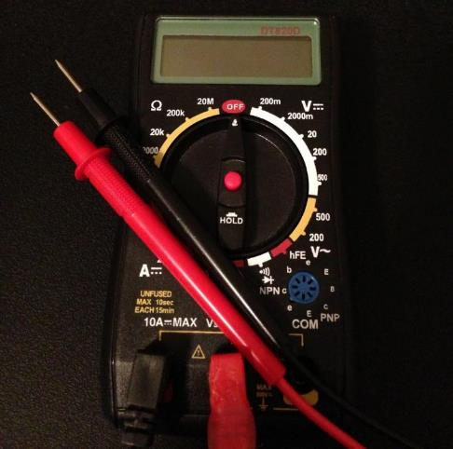
Tools Overview
Multimeter
This is how you find ground

Slide 17
Tools Overview
USB-UART cable
$8 on eBay
Soldering Iron
Magnifying Glass
Bright Light

Slide 18
UART’s Greatest Hits
Oh look! Linux shell! Most devices simply boot to shell, no auth required.
Some don't
Browsing the file system for interesting stuff (hidden_info.html)
Poking at it with an insider look - Seeing what happens on the inside, fuzzing devices and spotting the crash

Slide 19
Look what we can do!
Oh, Look! We found a cert! - making firmware encryption benign. (Belkin WeMo hack)
Owning one device opened the door to others.
Fuzzing with UART monitoring for crashes

Slide 20

Look what we can do!
Going to the dark side
Forensics? Changes via UART are volatile, reboot resets factory settings.
Using an Arduino with ethernet and UART to program the device in the field and leaving it there
Demo

Slide 21
Demo

Slide 22
More Stuff to try
Writing scripts to make an embedded device evil…
Throwable exploit platform
15$ Router on batteries acting as a pwn plug.

Slide 23
Protecting your UART interface
Want to leave UART in?
Boot to a login not a root shell
Disable logging to system console
Remove UART interfaces all together
Belkin WeMo fix
Upgraded firmware to require login to UART shell

Slide 24
Conclusion
THIS IS SO MUCH FUN AND SIMPLE!
Why don't you have a go?

